Slide 1

Cryptography
CS-486
September 20th, 2017 Paul A. Lambert

Slide 2
Cryptography Monday September 18th, 2017
Logistics
Homework #4
Hashing (see shasum)
https://docs.kali.org/introduction/download-official-kali-linux-images
Using block ciphers https://crypto.stanford.edu/~dabo/courses/OnlineCrypto/slides/04-using-block-v2-annotated.pdf
Padding
Message Authentication Codes
AEADs
https://www.iacr.org/cryptodb/archive/2002/EUROCRYPT/2850/2850.pdf
Raspberry Pi and Kali Distribution

Slide 3
Encryption Attacks
CPA - Chosen Plaintext Attack
An attacker can obtain the ciphertext for any provided plaintext (but does not have the key).
CCA - Chosen Ciphertext Attack
An attacker can also, in addition to being able to perform a CPA, obtain the plaintext for any provided ciphertext (but does not have the key).

Slide 4
Indistinguishability and Non-Malleability
IND - Indistinguishability
The advantage of a reasonable adversary determining what message was sent,
IND-CPA - Indistinguishability under a Chosen Plaintext Attack
IND-CCA - Indistinguishability under a Chosen Ciphertext Attack
INT - Integrity
INT-PTXT - Computationally infeasible to produce a ciphertext decrypting to a message which the sender has never encrypted
INT- CTXT – Computationally infeasible to produce a ciphertext not previously produced by the sender, regardless of whether or not the underlying plaintext is “new”
NM - Non-malleability
Is the advantage of a reasonable adversary being able to change the message to be meaningful
NM-CPA - Non-malleability under a Chosen Plaintext Attack
NM-CCA - Non-malleability under a Chosen Ciphertext Attack
WUF - Weakly unforgeable MAC
An attacker (with the capability of making chosen message attacks) is incapable of creating a new accepted message and tag pair (the message cannot have previously been queried).
SUF - Strongly unforgeable MAC
An attacker (with the capability of making chosen message attacks) is incapable of creating a new accepted message and tag pair (the tag cannot have previously been returned in response to a query - but the message may have been queried).
https://www.cs.jhu.edu/~astubble/dss/notes3c.pdf
http://cseweb.ucsd.edu/~mihir/papers/oem.pdf

Slide 5
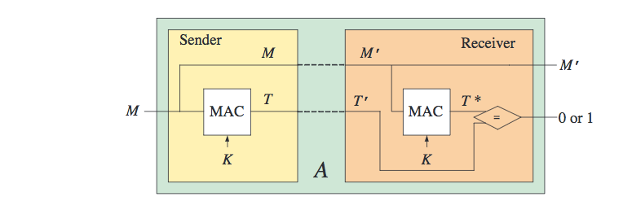
Message Authentication Codes
MAC algorithm standards :
FIPS PUB 113 Computer Data Authentication (DES based, withdrawn in 2002)
RFC 2104 & FIPS PUB 198-1 The Keyed-Hash Message Authentication Code (HMAC)
ISO/IEC 9797-1 Mechanisms using a block cipher
ISO/IEC 9797-2 Mechanisms using a dedicated hash-function
Message Authentication Codes
http://cseweb.ucsd.edu/~mihir/cse207/w-mac.pdf

Slide 6
Block Ciphers and Hashing
HW4
Write a Python command-line program to:
encrypt or decrypt a file using a contemporary block cipher
Pick a ‘good’ mode of operation
consider how to protect the key used for the encryption
Write a Python command-line program to:
Hash a file using at least two contemporary hash algorithms

Slide 7
Backup Material

Slide 8
Logistics for Class
Canvas CS-486-01
Primary repository for grading
URL for all homework submittals must be ‘linked’ into the appropriate Canvas assignment!
Github: https://github.com/CryptoUSF
Course material, class presentations, references, books
Sample code for assignments: https://github.com/CryptoUSF
Private student repositories,
too many if one per assignment per student
Wiki for additional class information and assignements
Piazza: CS486
Informal class conversations

Slide 9
Additional References
Courses:
https://crypto.stanford.edu/~dabo/courses/OnlineCrypto/
http://cseweb.ucsd.edu/~mihir/cse207/
Conferences:
Real World Cryptography
https://www.iacr.org
Mailing Lists and Standards:
http://csrc.nist.gov US Federal security specifications
https://trac.ietf.org/trac/sec/wiki Internet security standards
https://irtf.org/cfrg Internet cryptographic research

Slide 10
File Encryption with Classic Ciphers
HW1
Write a Python command-line program to encrypt or decrypt a file.
The program should: - provide command to encrypt or decrypt a file - provide option flags to select the algorithm to use for encryption or decryption - multiple simple ciphers should be implemented and should include: - the Caesar Cipher - another simple substitution cipher - a poly-alphabetic cipher - a transposition cipher For every algorithm you implement, please include a description of the algorithm in the docstring and a reference to the source description of the algorithm. References should be wherever possible to historic text for these older algorithms. A list of books are in Canvas for such references.
Example solution code for assignment: https://github.com/CryptoUSF/CS486/blob/master/code/cipher.py
Existing python library reference: pycipher

Slide 11
Cryptanalytic Toolkit
HW2
Write a cryptanalytic toolkit in Python to analyze the statistical properties of files.
Determine the frequency distribution of characters in an arbitrary string. Print out the Monogram distribution of the characters.
Determine the Bigram, Trigram or higher distribution of symbols in a file.
Example solution code for assignment: https://github.com/CryptoUSF/CS486/blob/master/code/cipher.py

Slide 12
Prime Numbers
HW3
Review section 4.2 of the “Handbook of Applied Cryptography” [HAC]. Closely read section 4.2.3 (Rabin-Miller)
Complete the ‘is_prime’ routine in: https://github.com/CryptoUSF/CS486/blob/master/code/prime.py
Your goal is to understand the nature of generating ‘good’ prime numbers. You should understand the implications of the selection of the number of iterations of the Rabin-Miller algorithm. This is a useful routine that you should write to a ‘production grade’. Look at other references and worked code example for the best way to select the number and value of the witness numbers.

Slide 13
Block Ciphers and Hashing
HW4
Write a Python command-line program to:
Encrypt or decrypt a file using a contemporary block cipher
Pick a ‘good’ mode of operation
Consider how to protect the key used for the encryption
Write a Python command-line program to:
Hash a file using at least two contemporary hash algorithms

Slide 14
Raspberry Pi
We will use a Raspberry Pi to get experience using contemporary analysis ‘tools’
Raspberry Pi
Excellent reference for what to acquire and how to setup:http://rpi.cs.usfca.edu/2017-fall
The first Pi project will use cryptographic related tools that are available in the Kali distribution: https://www.kali.org/
The tools do not necessarily require the Kali OS distribution and you may be able to simply install some of the tools on an existing Raspberry Pi OS installation.

Slide 15
Python References
Python Documentation (Python Web Site)
Transforming Code into Beautiful, Idiomatic Python (video)
Functional programming in Python
Writing Awesome Command-Line Programs in Python
Building Command Line Applications with Click
Look at repositories for Python crypto implementations and read the code.

Slide 16
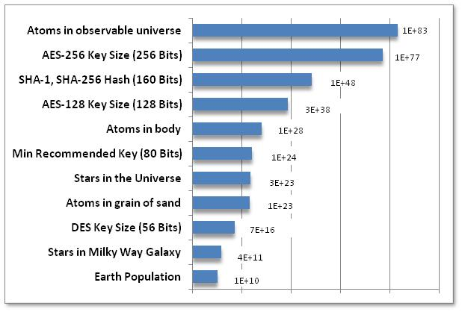
Very Big Numbers
“Astronomy has long been humanity's go-to subject when it comes to contemplating the truly enormous. But actually, if 2¹²⁸ is so much more vast than the number of stars in the observable universe (10¹⁵ times more vast*, or 4,000,000,000,000,000 in long-hand notation), then even the name "astronomical" is rather inadequate.”
-- from Economist
http://www.economist.com/blogs/johnson/2011/01/big_numbers

